Slide 1
Using HTML Tables
1

Slide 2
Using the <table>,
<tr>, and <td> Tags
Graphical tables are enclosed within a two-sided
<table> tag that identifies the start and ending of
the table structure.
Each row of the table is indicated using a two-sided
<tr> (for table row).
Within each table row, a two-sided <td> (for table data) tag indicates the presence of individual table cells.
2

Slide 3

The General Table Syntax
<table>
<tr>
<td> First Cell </td>
<td> Second Cell </td>
</tr>
<tr>
<td> Third Cell </td>
<td> Fourth Cell </td>
</tr>
</table>
two rows
two columns
4

Slide 4
Columns within a Table
HTML does not provide a tag for table columns.
In the original HTML specifications, the number of columns is determined by how many cells are inserted within each row.
– for example, if you have four <td> tags in each table row, that table has four columns
Later versions of HTML provide increased support for controlling the appearance of table columns.

Slide 5
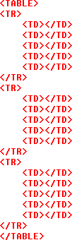
HTML Structure of a Table
beginning of the
table structure
table cells
You do not need to indent the <td> tags or place them on separate lines, but you may find it easier to interpret your code if you do so.
After the table structure is in place, you’re ready to add the text for each cell.
first row of six
in the table
end of the table
structure

Slide 6
Creating Headings with the <th> Tag
HTML provides the <th> tag for table headings.
Text formatted with the <th> tag is centered within the cell and displayed in a boldface font.
The <th> tag is most often used for column headings, but you can use it for any cell that you want to contain centered boldfaced text.

Slide 7
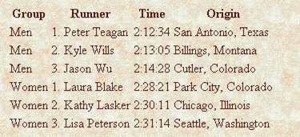
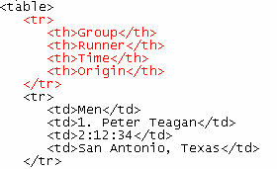
Adding Table Headings to the Table
Text in cells formatted with the <th> tag is bold and centered above each table column.
table
headings

Slide 8
Vertical Table Headers
To use the first column as table headers, define the first cell in each row as a <th> element:
<tr> <th>Firstname</th> <td>Jill</td> <td>Eve</td> </tr>
By default, table headers are bold and centered:
To left-align the table headers, use the CSS text-align property:
Example
th { text-align: left; }

Slide 9
Creating a Table Caption
HTML allows you to specify a caption for a table.
The syntax for creating a caption is: <caption align=“alignment”>caption text</caption>
alignment indicates the caption placement
a value of “bottom” centers the caption below the table
a value of “top” or “center” centers the caption above the table
a value of “left” or “right” place the caption above the table to
the left or right

Slide 10
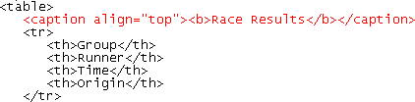
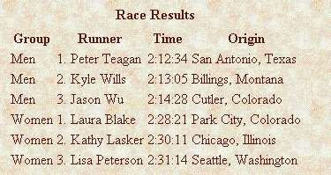
Result of a Table Caption
caption text
caption will be centered above the table

Slide 11
Modifying the Appearance of a Table
You can modify the appearance of a table by adding:
gridlines
borders
background color
HTML also provides tags and attributes to control the placement and size of a table.

Slide 12
Adding a Table Border
By default, browsers display tables without table borders.
A table border can be added using the border attribute to the <table> tag.
The syntax for creating a table border is: <table border=“value”>
– value is the width of the border in pixels
The size attribute is optional; if you don’t specify a size, the browser creates a table border 1 pixel wide.

Slide 13

Tables with Different Borders Values
This figure shows the effect on a table’s border when the border size is varied.

Slide 14
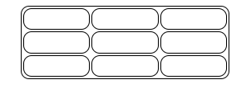
HTML TABLE ATTRIBUTES
To add a border, use the CSS border property on table, th, and td elements
table, th, td { border: 1px solid black; border-collapse: collapse;
background-color: #96D4D4; }
Round table border can be set using border-radius property on table th and td elements
table, th, td { border: 1px solid black; border-radius: 10px; }

Slide 15
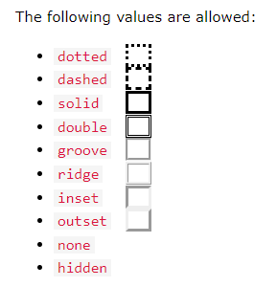
HTML TABLE ATTRIBUTES
With the border-style property, you can set the appearance of the border.
th, td {
border-style: dotted;
}
With the border-color property, you can set the color of the border.
Use the style attribute with the width or height properties to specify the size of a table, row or column.

Slide 16
Applying a Background Color
Table elements support the bgcolor attribute.
To specify a background color for all of the cells in a table, all of the cells in a row, or for individual cells, by adding the bgcolor attribute to either the <table>, <tr>, <td>, or <th> tags as follows:
<table bgcolor=“color”>
<tr bgcolor=“color”>
<td bgcolor=“color”>
<th bgcolor=“color”>
– color is either a color name or hexadecimal color value

Slide 17
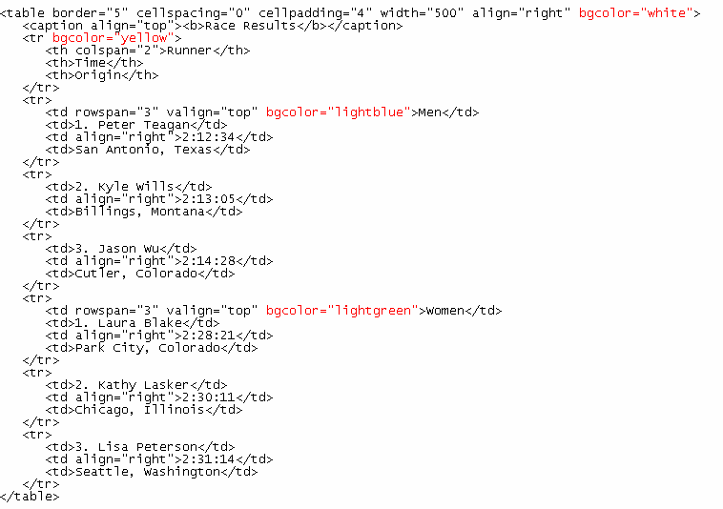
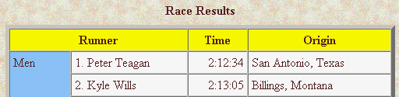
Specifying Table, Row, and Cell Colors

Slide 18


The bordercolor Attribute
By default, table borders are displayed in two shades of gray that create a three-dimensional effect.
The syntax for the bordercolor attribute is:
<table bordercolor=“color”>
– color is an HTML color name or hexadecimal color value
Internet Explorer and Netscape apply this attribute differently.
<table border=“10” bordercolor=“blue”>
Internet Explorer
Netscape

Slide 19

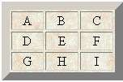
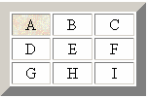
Applying a Table Background
Add a background image to your tables using the
background attribute.
A background can be applied to the entire table or to a cell.
parch.jpg
<table background=“parch.jpg”>
<td background=“parch.jpg”>

Slide 20
Controlling Cell Spacing
The cellspacing attribute controls the amount of space inserted between table cells.
The syntax for specifying the cell space is:
<table cellspacing=“value”>
value is the width of the interior borders in pixels
the default cell spacing is 2 pixels
Cell spacing refers to the space between the cells.

Slide 21
Defining Cell Padding
To control the space between the table text and the cell borders, add the cellpadding attribute to the table tag.
The syntax for this attribute is:
<table cellpadding=“value”>
value is the distance from the table text to the cell border, as
measured in pixels
the default cell padding value is 1 pixel
Cell padding refers to the space within the cells.

Slide 22
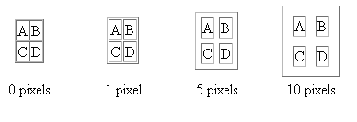
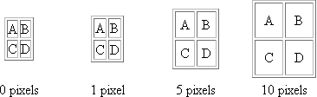
Tables with Different Cell Spacing Values
different cell spacing values
different cell padding values

Slide 23
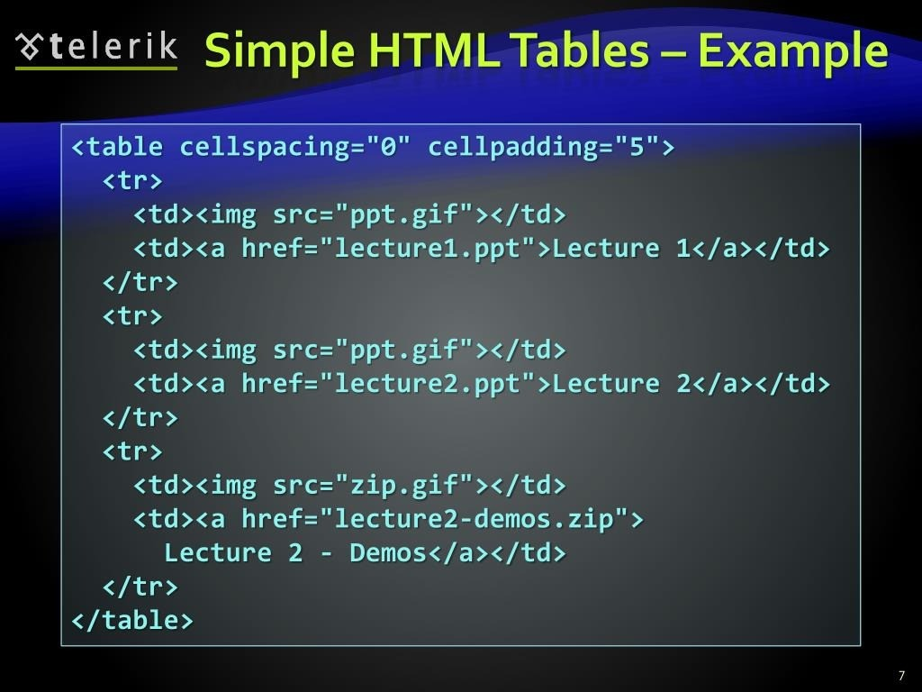

Slide 24
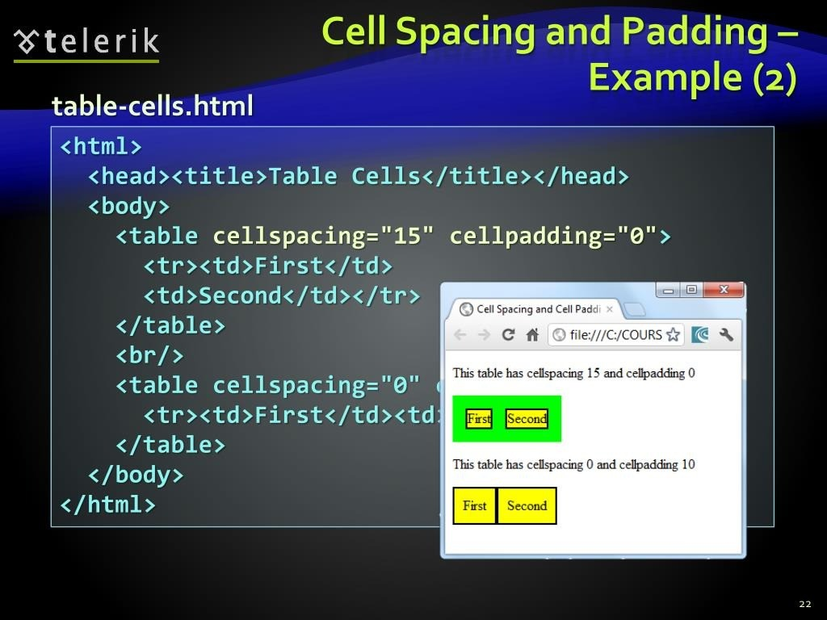
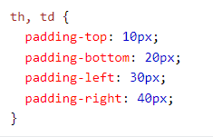

Slide 25
Defining the Table Size
The syntax for specifying the table size is:
<table width=“size” height=“size”>
– size is the width and height of the table as measured in pixels or as a percentage of the display area

Slide 26
Aligning a Table on the Web Page
By default, a browser places a table on the left margin of a Web page, with surrounding text placed above and below the table.
To align a table with the surrounding text, use the align attribute as
follows: align=“alignment”
alignment equals “left”, “right”, or “center”
left or right alignment places the table on the margin of the Web page
and wraps surrounding text to the side
center alignment places the table in the horizontal center of the page,
but does not allow text to wrap around it

Slide 27
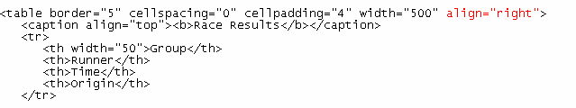

Results of a Right-Aligned Table

Slide 28
Spanning Rows and Columns
To merge several cells into one, you need to create a
spanning cell.
A spanning cell is a cell that occupies more than one row or column in a table.
Spanning cells are created by inserting the rowspan
and colspan attribute in a <td> or <th> tag.
The syntax for these attributes is:
rowspan=“value” colspan=“value”
– value is the number of rows or columns that the cell spans in the table

Slide 29
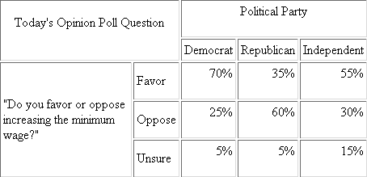
Example of Spanning Cells
This cell spans two columns and two rows
this cell
spans three
columns
This cell
spans three
rows

Slide 30
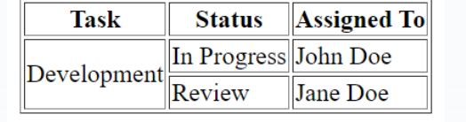
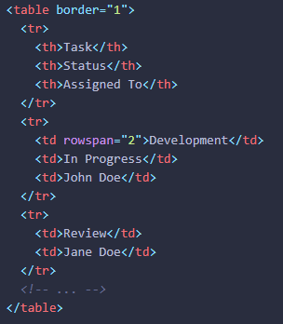
Row span
Example

Slide 31
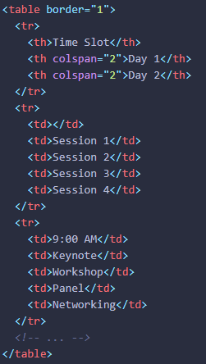
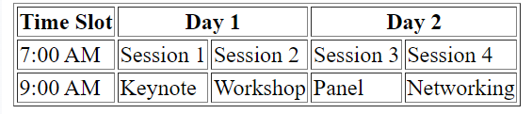
Col span
Example

Slide 32
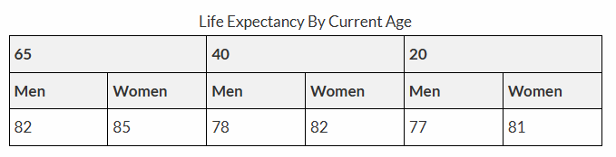
Example
Create following

